Slide 1
Toxic Comment Classification
Project Report
Shaishav Harshadbhai Shah
shah.sh@ufl.edu

Slide 2
Motivation

Slide 3
Motivation
In today’s world, social media has become one of the most efficient ways for people to communicate and discuss. People can share their ideas, their feelings, their opinions, the events happening in their life as well as react to the comments posted by other people.
Considering all these advantages, social media may seem like a paragon for communication, but it’s a double-edged sword as it can easily be abused by toxic comments from some users. While traditional moderators are in place to identify these types of comments and take appropriate actions, that is not the most efficient way for solving this problem.
A machine learning model that can perform this job of identifying and reporting toxic comments autonomously would be great to have and has many applications.

Slide 4
Dataset

Slide 5
Dataset
Kaggle Toxic Comment Classification Challenge
Six labels: toxic, severe toxic, obscene, threat, insult and identity hate
Multi-label classification problem
Frequency distribution
Comment length distribution
Comment length distribution by label

Slide 6
Preprocessing

Slide 7
Preprocessing
Remove longer length comments
Remove special characters
Remove stop words
Stemming
Lemmatising
Count Vectorizing

Slide 8
Solutions

Slide 9
Solutions
Problem Transformation Methods
Binary Relevance
Classifier chain
Label Powerset
Adaptation Algorithms
ML-KNN
BP-MLL Neural Network

Slide 10
Binary Relevance
Binary Relevance
Simplest type of transformation method
Separate classifier for each label is created
Interdependence of different labels is ignored
Each label is solved individually
Each classifier simply predicts whether the comment belongs to that label or not
Union of all classifier’s prediction is taken as multi-label output

Slide 11
Classifier Chain
Classifier Chain
Overcomes the disadvantage of the Binary Relevance method and takes the interdependence of different labels into account
Creates a chain of classifiers where each classifier uses the predictions made by all the classifiers up to itself
This way the label correlations are considered

Slide 12
Label Powerset
Label Powerset
Creates a powerset of all the possible correlations between the labels
Each combination of labels servers as an input to the single-label classifier
Transforms our multi-label problem to multi-class classification problem
Suitable method for our dataset

Slide 13
ML-KNN
ML-KNN
Adapted Multi-label version of KNN
Unseen instances obtained from the label sets of neighboring instances
Maximum a posteriori (MAP) rule is used to decide the label set the unseen instance

Slide 14
BP-MLL Neural Network
BP-MLL Neural Network
Based on traditional multi-layer feed-forward neural network
Goal is to optimize the pair-wise ranking error
The hidden layer is fully connected with the input and output, and do not have any connections to the outside world

Slide 15
Evaluation

Slide 16
Evaluation Metrics
Hamming Loss
Hamming Loss is characterized as the ratio of wrong output labels to the total number of labels. Hamming Loss for a multi-label problem can be implemented by assigning equal weight to each label, and then combining the predictions of each label to produce the final loss value.

Slide 17
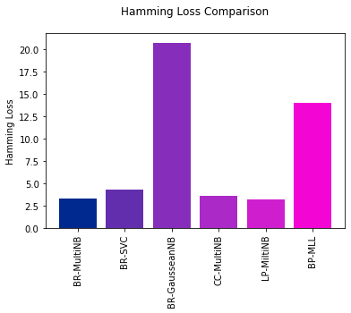
Evaluation Metrics
Hamming Loss - Comparison

Slide 18
Evaluation Metrics
Log Loss
Log loss analyzes the accuracy of a model by penalizing the false results produced. It is suited only for the problems having two or more labels. For calculating the Log loss, each label must be assigned a probability rather than simply giving out the most favorable label.

Slide 19
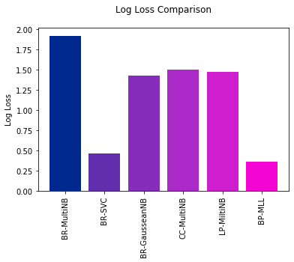
Evaluation Metrics
Log Loss - Comparison

Slide 20

Thank You!
Shaishav Harshadbhai Shah
shah.sh@ufl.edu

